Slide 1

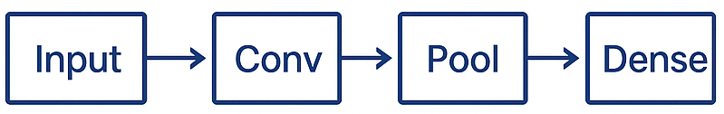

Why Sequential Isn’t Enough
Sequential API
Simple, Straight-line model
Limited Customization
Advanced Model-building APIs
Functional API
Model Subclassing
Custom Layers

Slide 2
Two Flexible Approaches
Functional API
Model Subclassing
Input
tf.keras.Model
Layer
Layer
def __init__():
…
def call():
…
Output

Slide 3
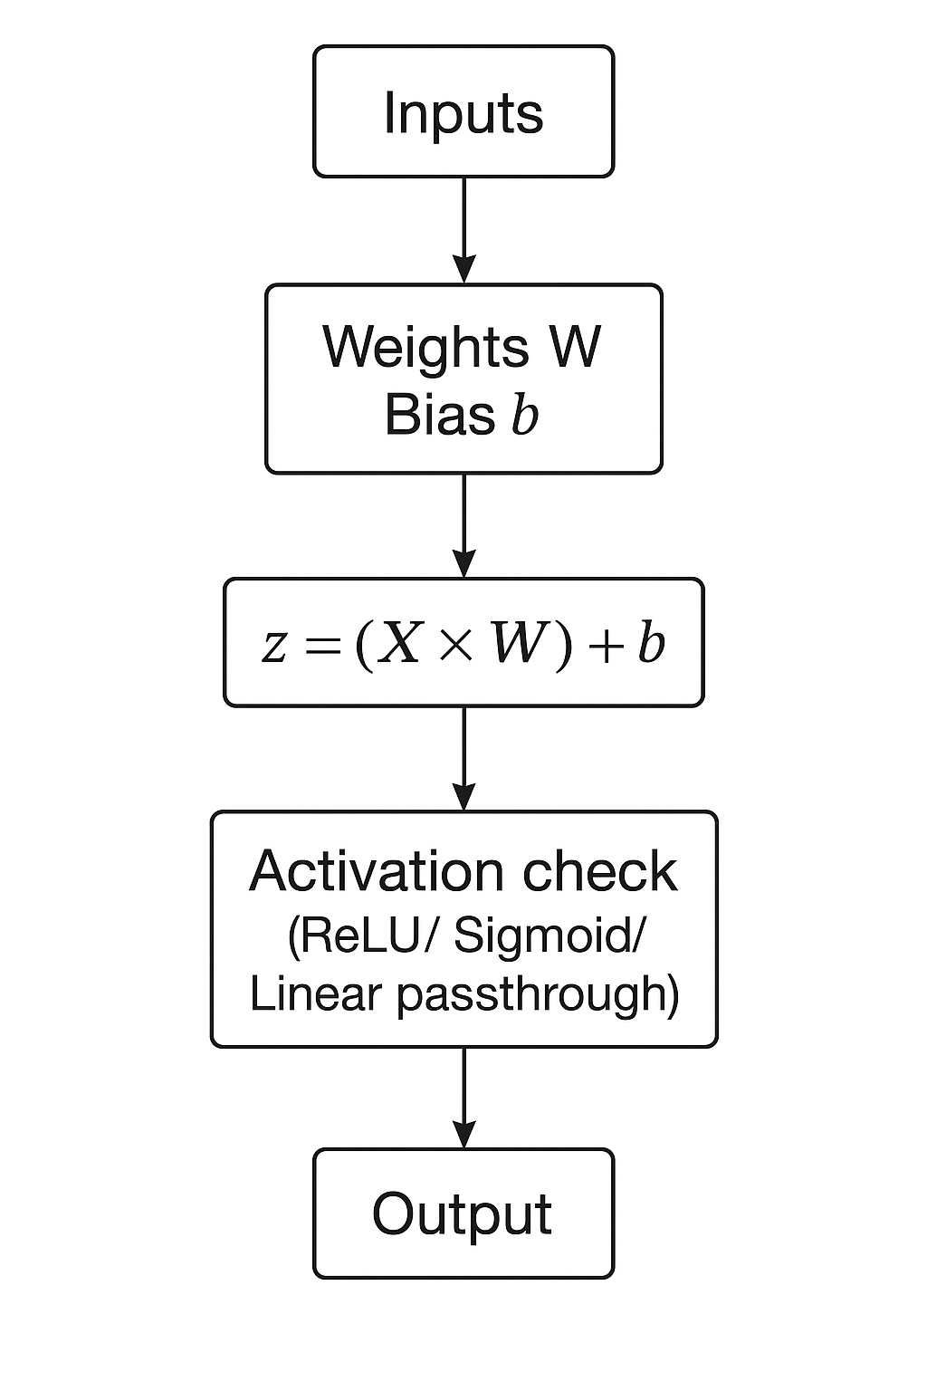
Going Past the Standard Layers
Why Custom Layers?
Logic for desired activation in layers
Full control over weights and biases
Reusable blocks

Slide 4
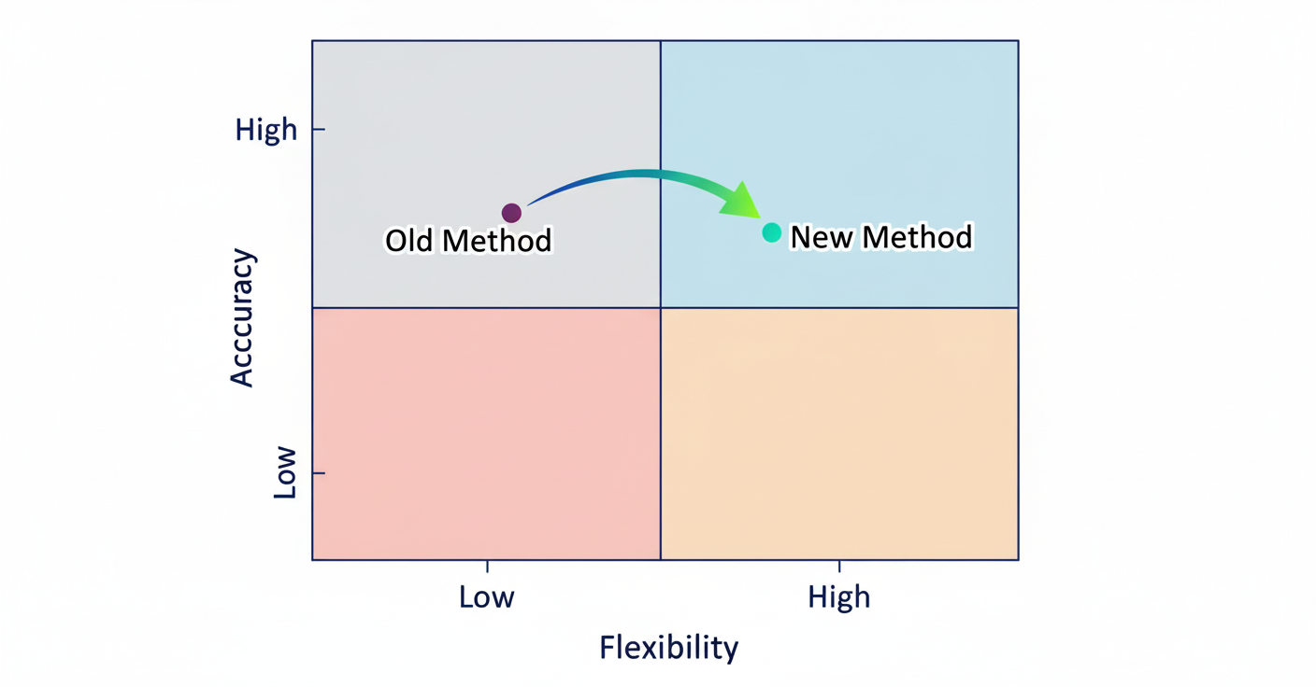
Same Accuracy, More Flexibility
Functional API, Subclassing, Custom layers
Sequential API

